Slide 1
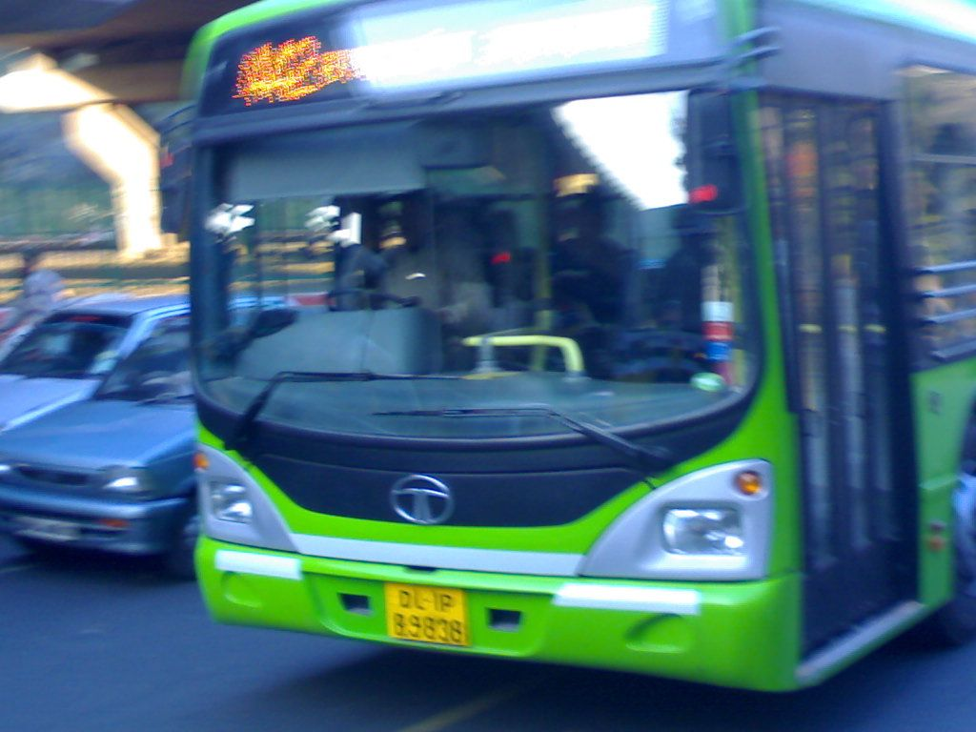

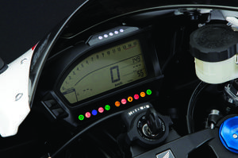


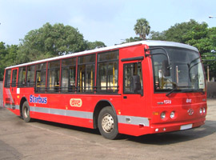

BikeTracking System
Bike Tracking System
Bike Tracking System
Complete Solution provided by
Innovative Embedded Systems Pvt. Ltd.
(An ISO 9001:2000 company)
Embedding Intelligence
Everywhere
Regd. Office: 148-B Lakhanpur ,Awadhpuri kanpur-208024
Admin Office: S4, SIIC, I.I.T. Kanpur
www.iembsys.co.in Email: sales@iembsys.co.in
Tel. 09935551952

Slide 2
Our Strength
State of the art Indigenous technology foe both hardware and software.
Strong technical team consists for many alumnus of IIT.
24x7 support because of in-house technology and dedicated call centre.
Being a indigenous manufacturer customization is easily possible as per client requirement .
High quality control product assurance.
ISO Certified company since .
CE certified product.
Dedicated office in Dhanbad for client support.
Proven product for last 5 years across India.
Tie-up with premier technical institute of India (IIT Kanpur).

Slide 3
Client Portfolio
. Motherdairy
. Wockhardt
. Rohit Surficent Private Limited

Slide 4

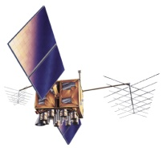
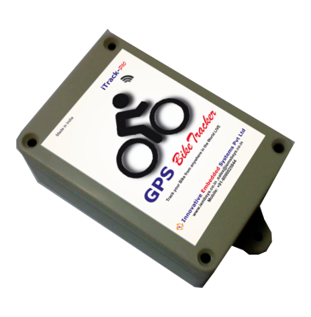

How VTS Works?
Global
Positioning
Satellite
GSM/GPRS
Network
iTrack
Server
iTrack
Database
SMS
GPRS
www
Internet
Internet Users
www.itracksolution.co.in
Vehicle with iTrack-P 10

Slide 5
Key Features
Know Current Location of the Bike through web on computer or mobile
Online halt report of the vehicle for used define interval
Accurate estimation of the distance travelled by the vehicle.
Online Speed report of the vehicle
Geo-fence and route creation facility to define the boundary or route of the Bike.
Automatic ticket generation for client, so that client can track the location of their shipment.
Generate online report in PDF, Excel format for any chosen interval
Instant alert generation via GPRS/Email/SMS on over speeding, geo-fence violation, route deviation etc.
Switch of ignition through mobile or computer on vehicle theft.
Inbuilt backup battery for information to owner on power disconnection
Customization as per client requirement

Slide 6
Hardware
Quad-band GSM: Modules operates at 850/900/1800/1900 MHz
GPS Module supports 210 PRN channels and it has-165dBm tracking
sensitivity and supports NMEA and PMTK Protocol
IP65 Waterproof Dustproof enclosure with a compact design and size
Hardware has slot to insert any sim-card with GPRS facility to transmit
data to designated server.
Hardware supports Serial communication (RS-232) Protocol
System has in-built battery support for minimum 24 hours with internal
rechargeable battery as well as external Battery support either 6V DC or
18 V DC from vehicle battery.
Data Storage: system works in off-line mode too for no network coverage
areas and provides all the data once the vehicle enters in the GPRS zone
System has facility to reset or upgrade system both locally and remotely
by SMS Command.
.

Slide 7
Software
. Real-time system for tracking of Bikes on map .
. Facility to generate SMS Alert & email for concerned personnel/Official.
. Map Replay facility
. Facility of Geo-fencing
. Facility to create landmarks and routes
. Software has many of reporting features like distance report , Halt Report , Speed report , Live location , Travel Report etc.
. Reports can be collected in excel and pdf formats also.
. Software generates many alerts like geo-fence violation, speed alert,
movement and halt alert on mobile as well as on web also.

Slide 8
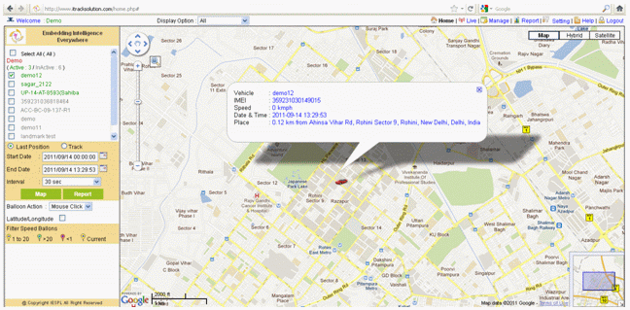
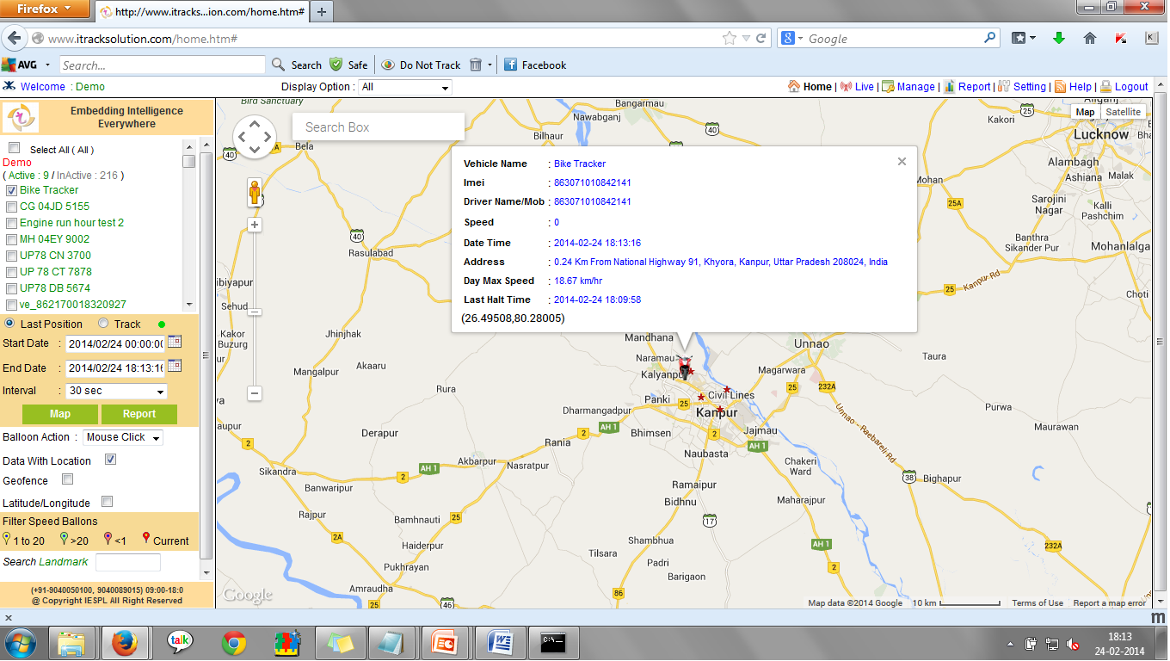
Track Bike Online

Slide 9
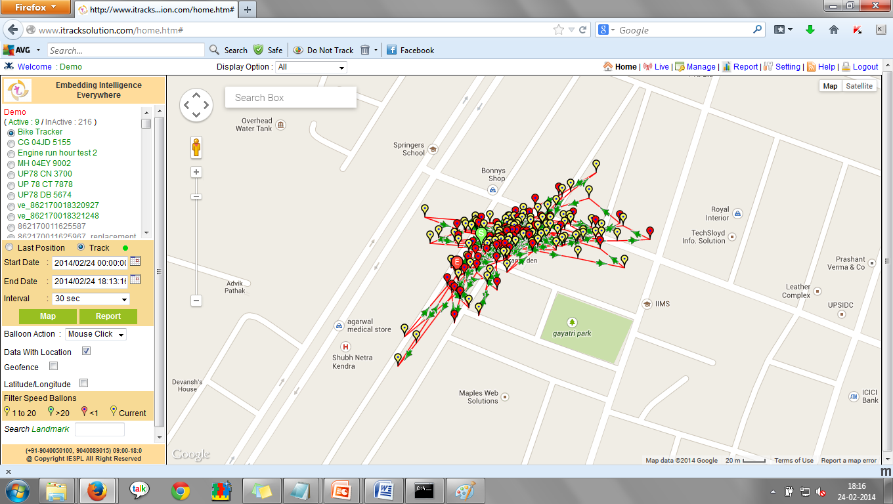
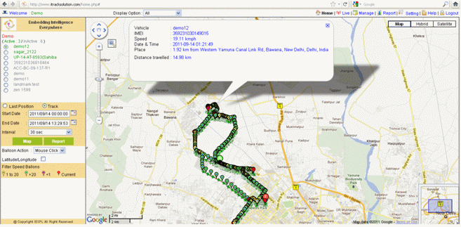
Track Bike Online

Slide 10
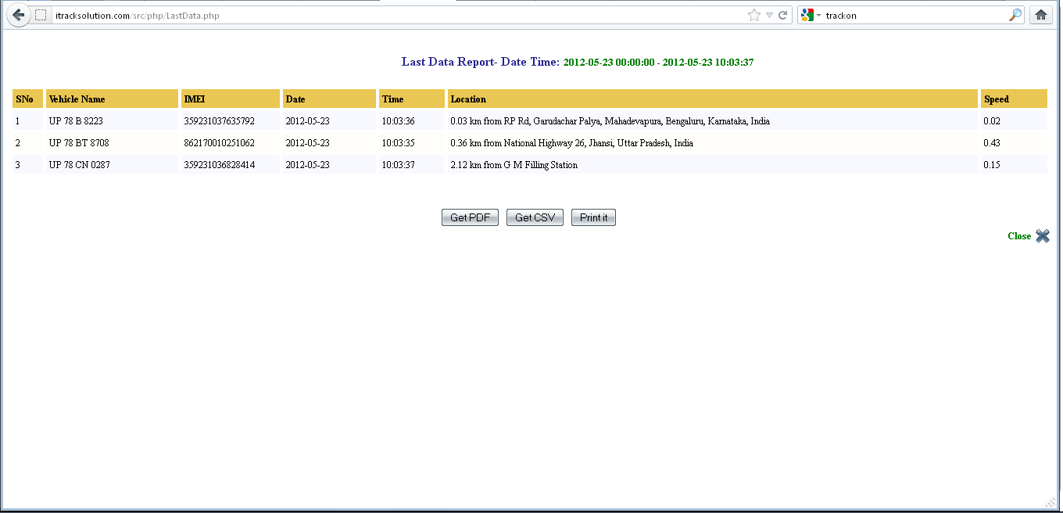
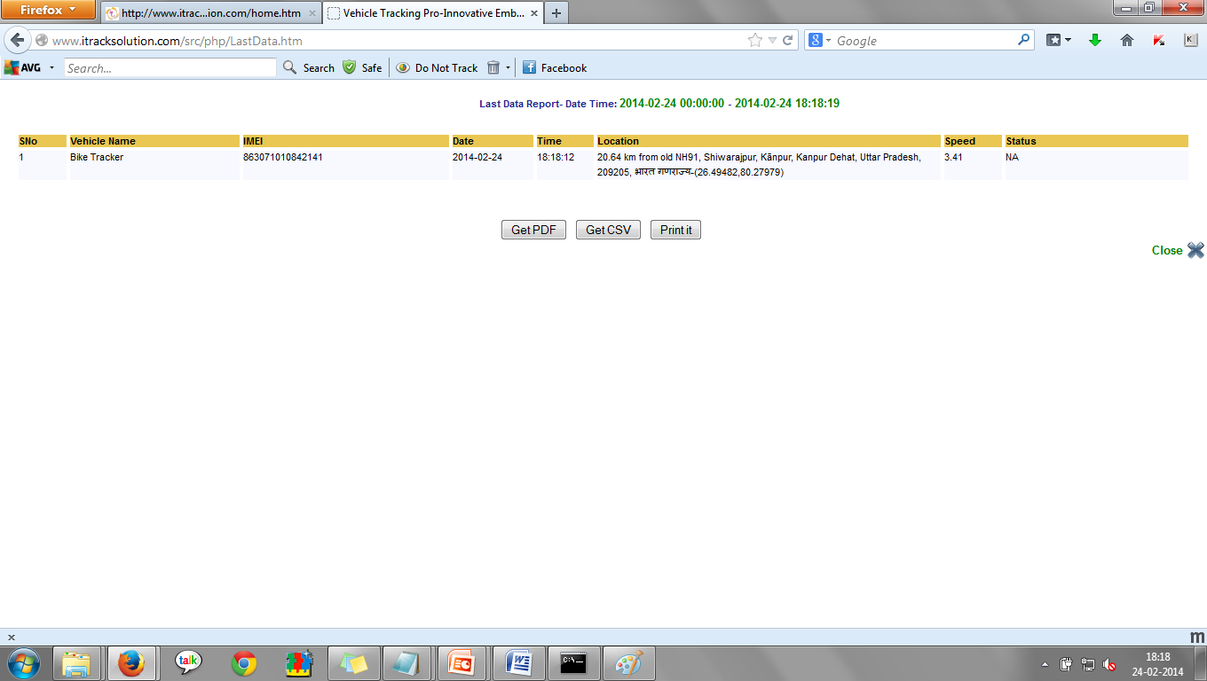
Last Position Report

Slide 11
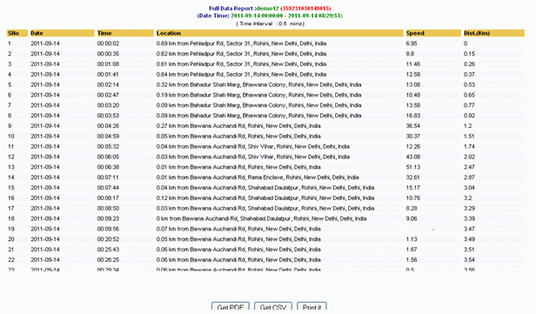
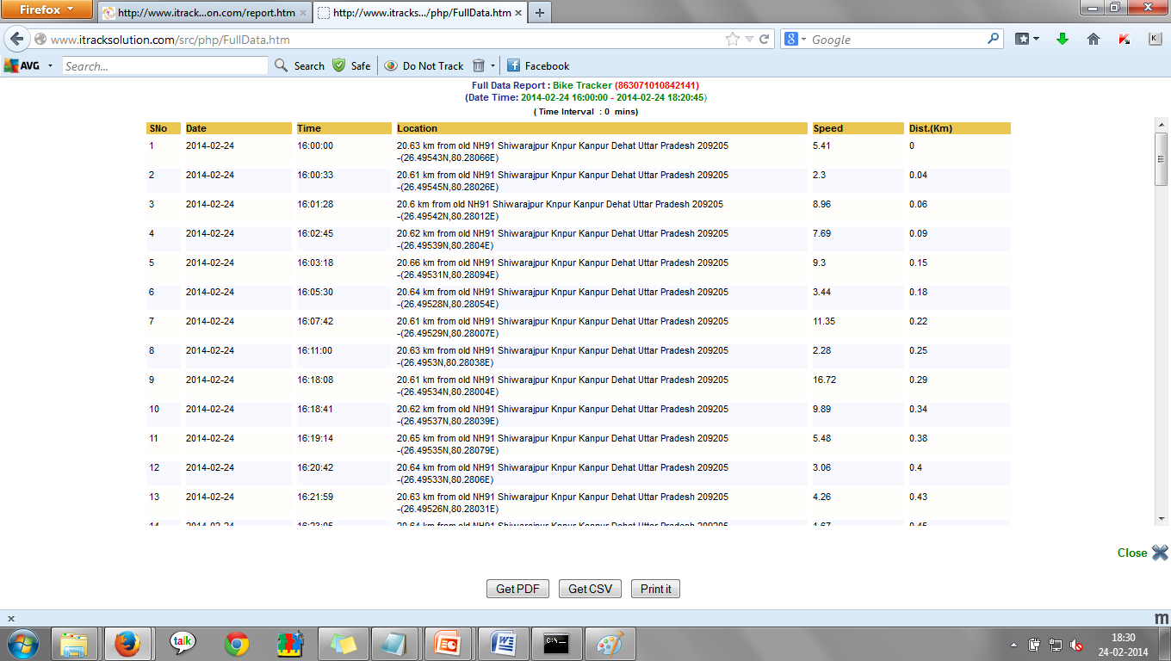
Track Report

Slide 12
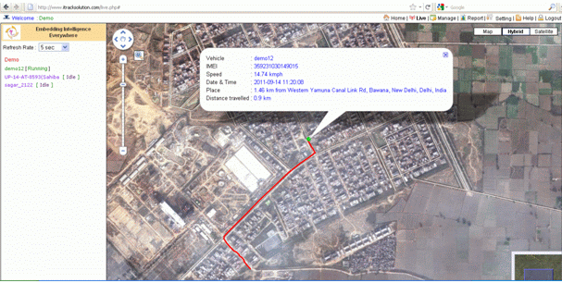
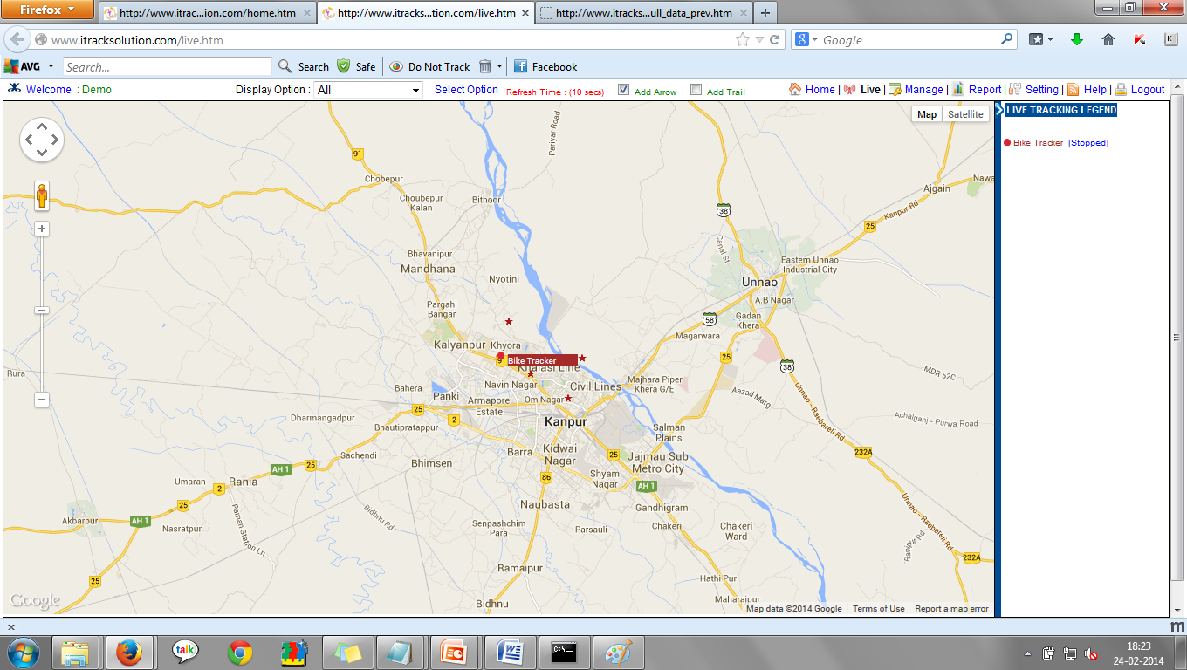
Live Tracking

Slide 13
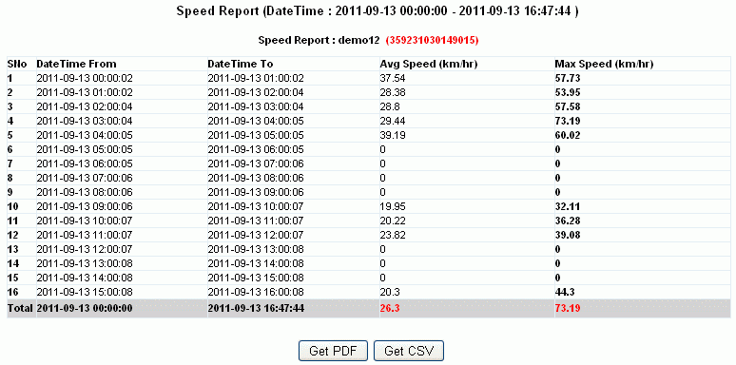
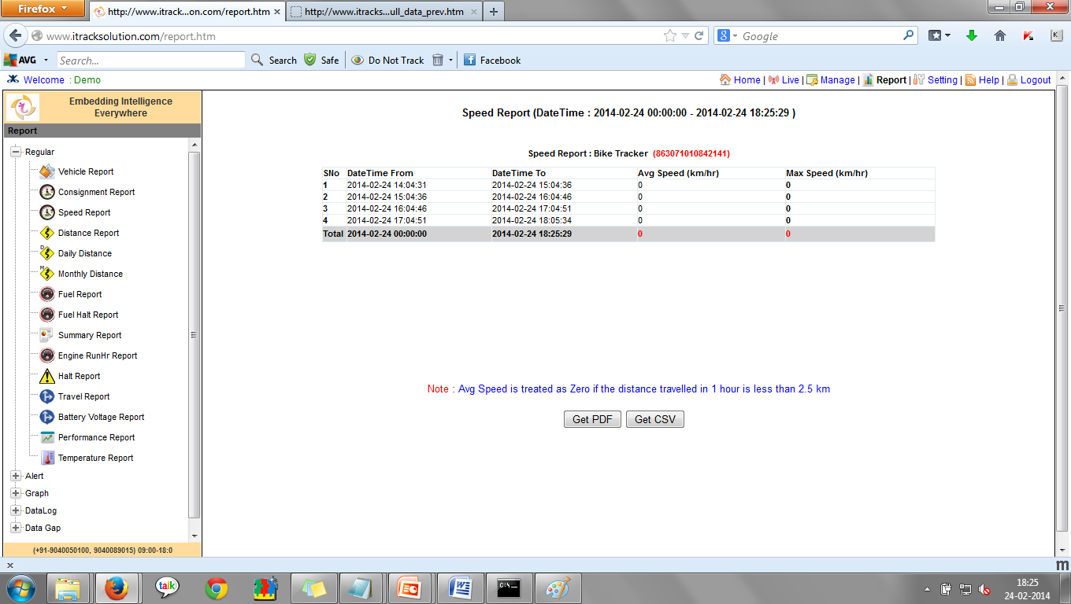
Speed Report

Slide 14
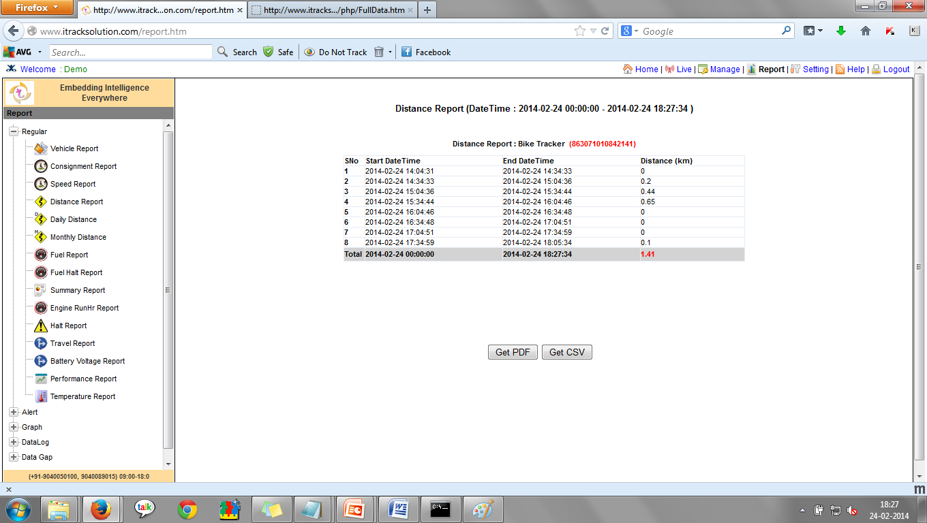
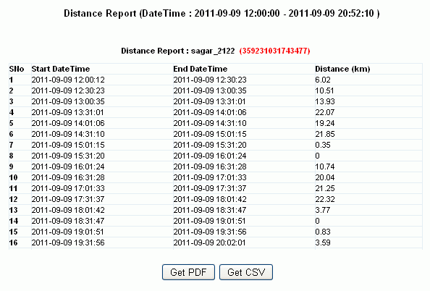
Distance Report

Slide 15
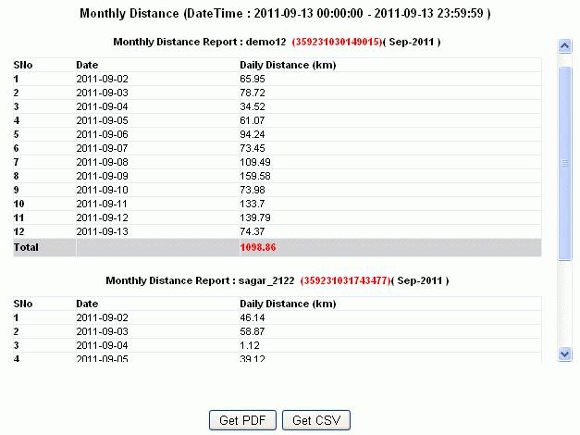
Monthly Distance Report

Slide 16
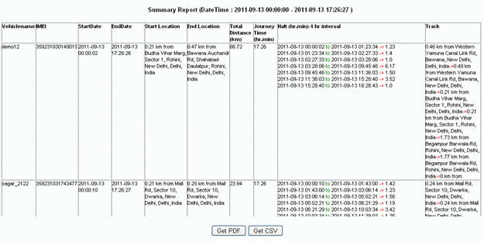
Summary Report

Slide 17
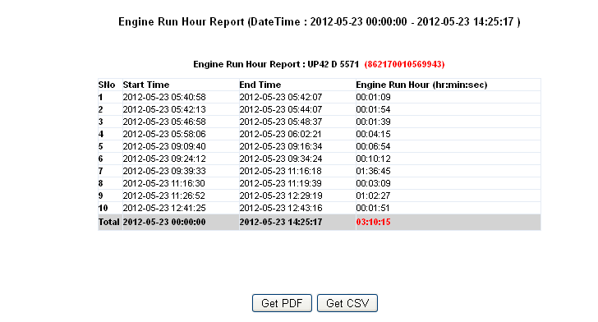
Engine Run hr Report

Slide 18
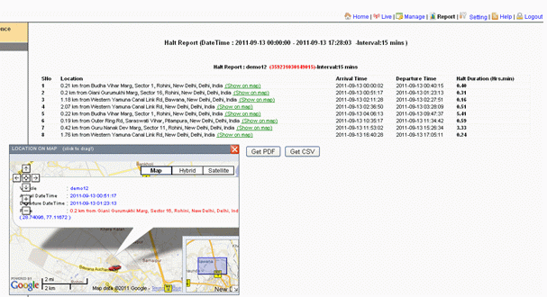
Halt Report

Slide 19
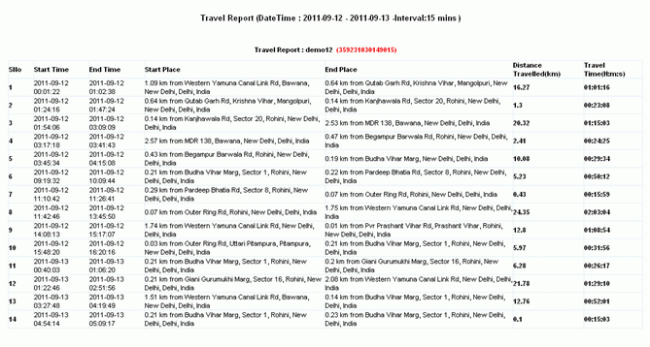
Travel Report

Slide 20
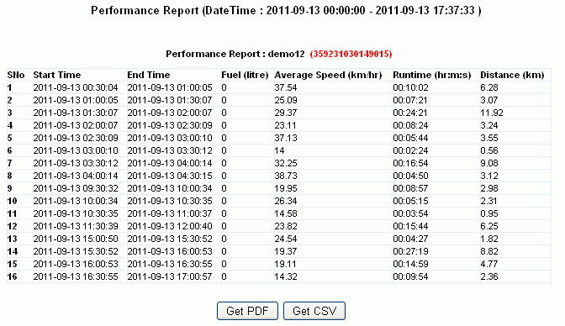
Performance Report

Slide 21
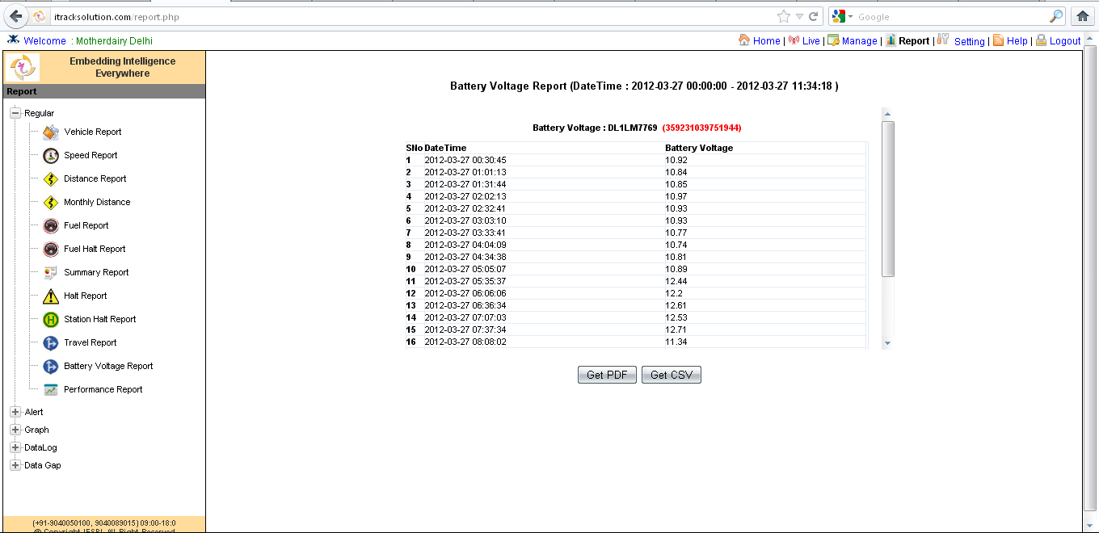
Battery Voltage Report

Slide 22
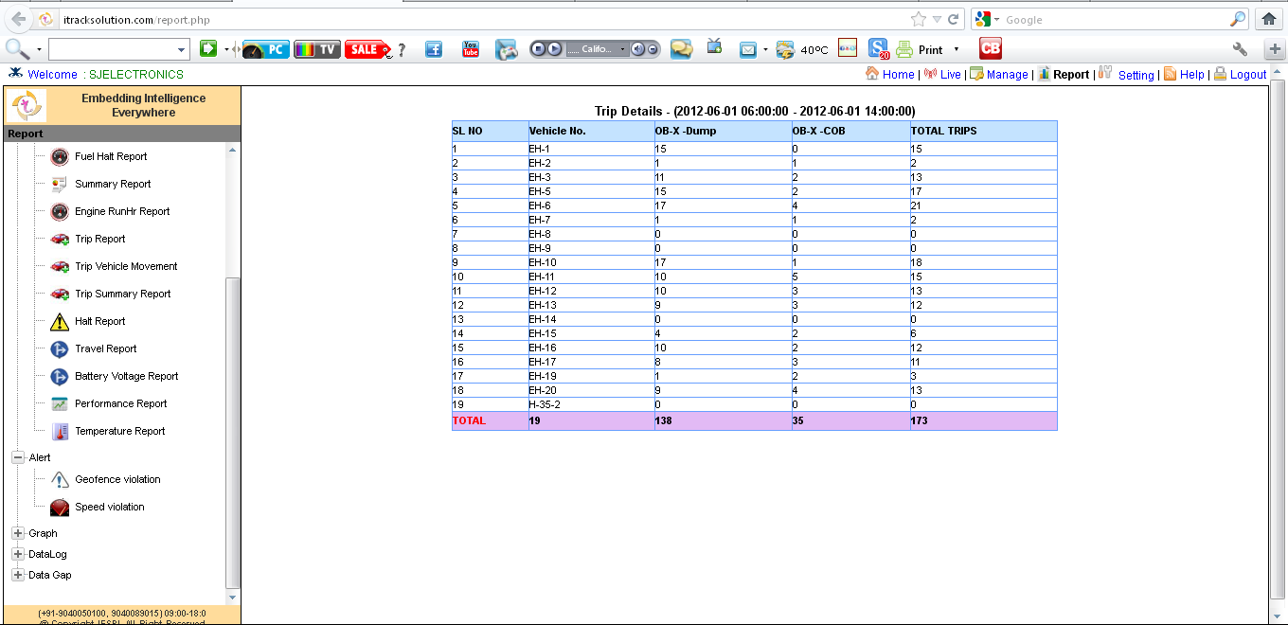
Trip Report

Slide 23
Thank You !
Innovative Embedded Systems Pvt. Ltd. (An ISO 9001:2000 company)
www.iembsys.co.in , Email: sales@iembsys.co.in
Tel. 9935551952
Regd. Office: 148-B Lakhanpur ,Awadhpuri kanpur-208024
Admin Office: S4, SIIC, I.I.T. Kanpur - 208016
Delhi Office: 65, Kalu Sarai, Sarvapriya Vihar, New Delhi – 110016
Manufacturing: Kh. No. 1114-1118, Salempur Industrial Area, Roorkee - 247667
Embedding Intelligence
Everywhere

